Slide 1


Virtual Server Monitoring and Performance Optimization
Name:- Shivasagar Desai
Date :- 13-3-2026

Slide 2
Problem Statement
•The company operates multiple virtual servers hosting critical applications
• Monitoring server performance manually is difficult to Handel to them
• High CPU or memory usage can lead to performance issues
• A monitoring system is required to analyze server health and resource usage

Slide 3
Dataset Overview
• server monitoring logs where there in Dataset
• Each record represents a server performance
• The dataset includes system metrics and metadata
Important columns:
• CPU Utilization
• Memory Usage
• Disk IO
• Network Traffic
• Uptime and Downtime
• Server Location and OS Type

Slide 4




Data Pipeline Architecture
CSV Dataset
Data Ingestion (Python)
Data Cleaning & Validation and downloaded the new csv file
Azure SQL Database for Data storing
Processed Dataset and connection to Power BI from Azure SQL
Power BI Dashboard

Slide 5
Data Pipeline Implementation (Python)
The server log dataset was loaded from the CSV file using Python and the Pandas library.
Basic data quality checks were performed to identify missing values and duplicate records.
The timestamp column was converted into datetime format to enable time-based analysis.
Additional metrics such as Total Network Traffic, Availability Rate, and Server Health Score were created to generate meaningful insights from the server logs.
The processed dataset was then exported and used for building the Power BI dashboard.
This screenshot shows the Python script used to load the dataset, perform data cleaning, and generate additional metrics for server performance analysis.
The complete Python implementation for this pipeline is available in the GitHub repository linked below.
https://github.com/shivasagardesai/server-monitoring-data-pipeline

Slide 6
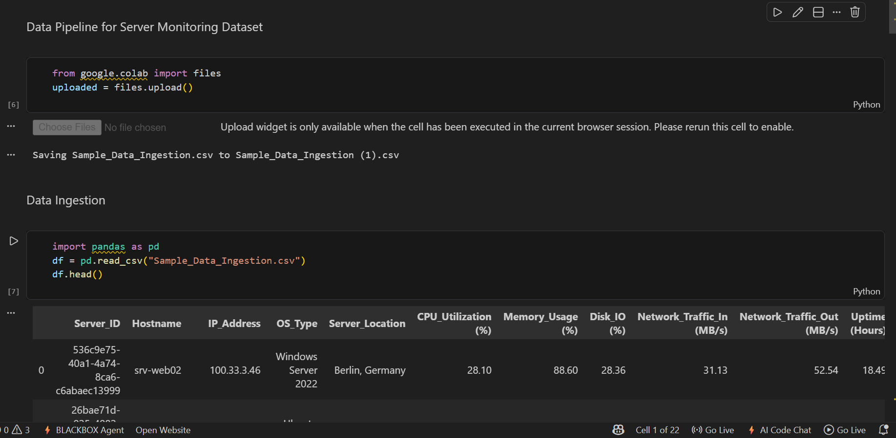

Slide 7
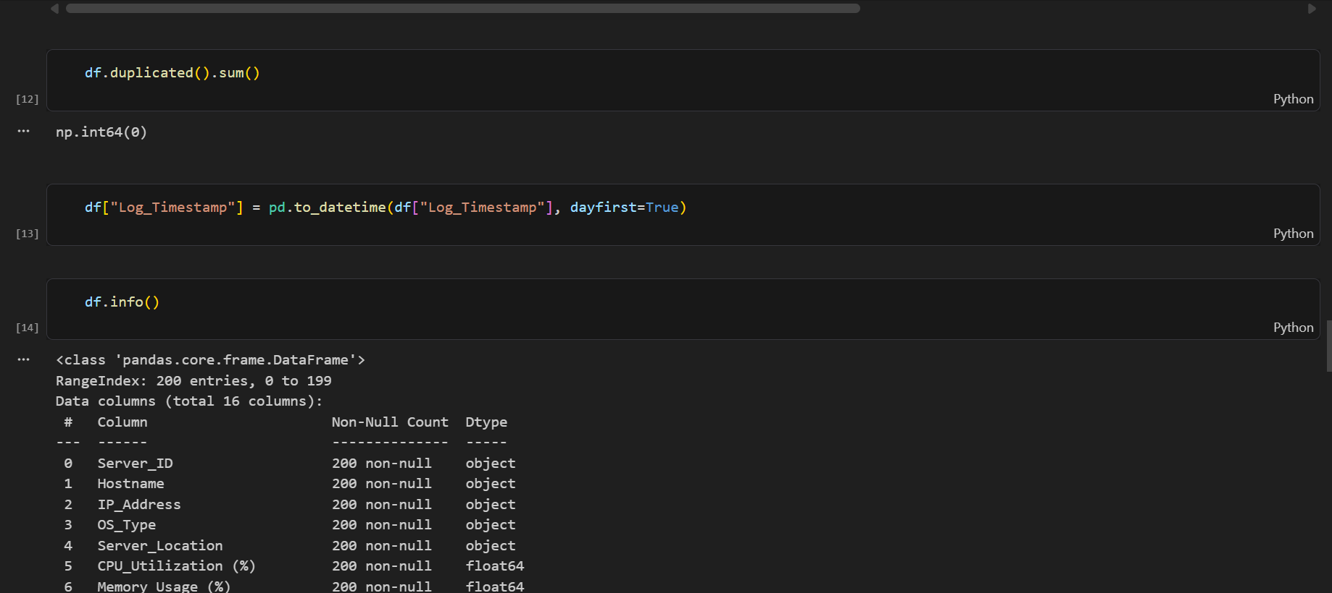

Slide 8
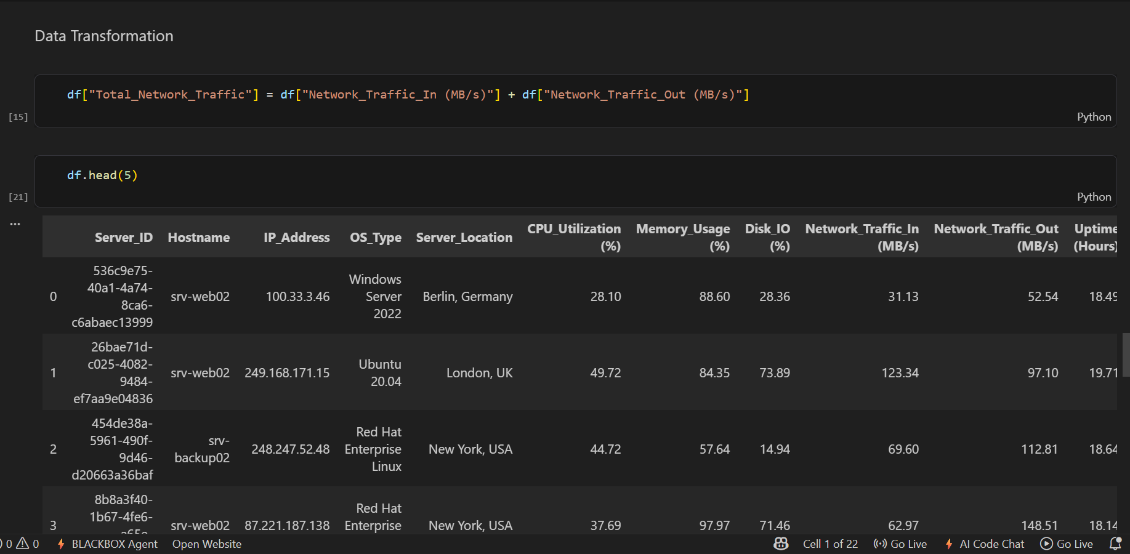

Slide 9
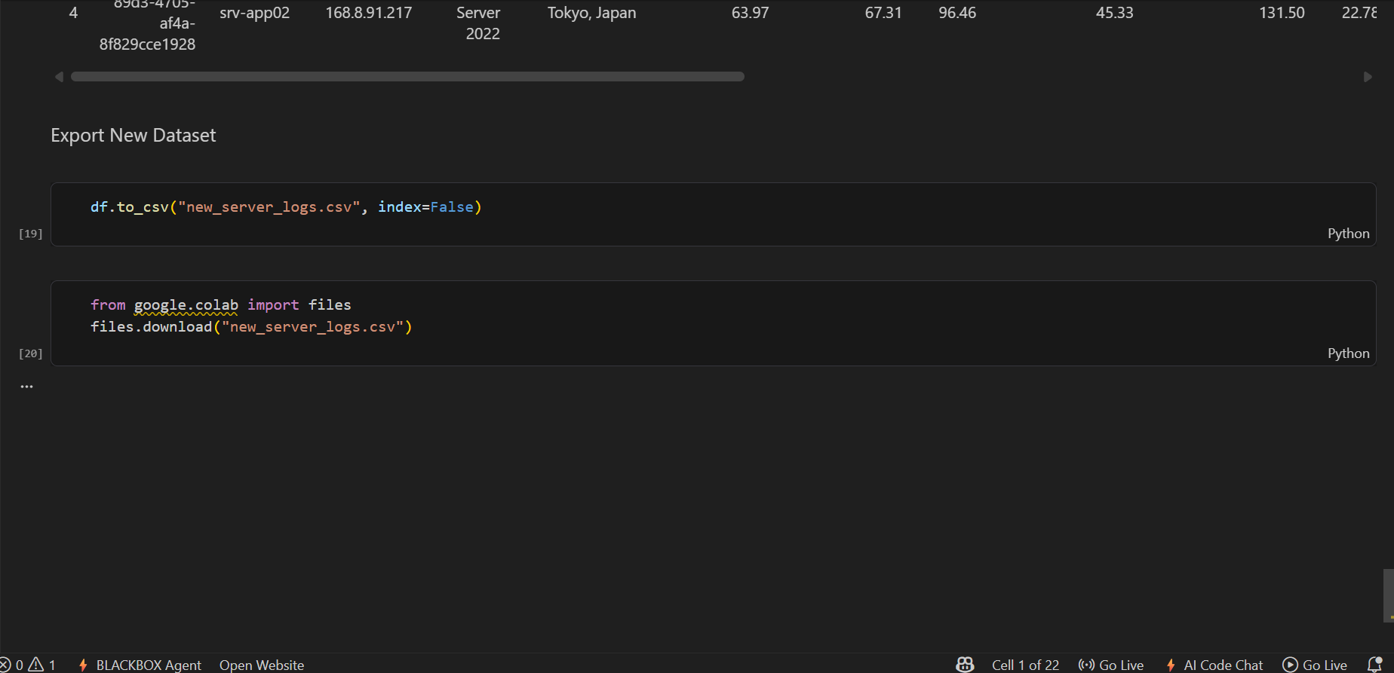

Slide 10
Power BI Dashboard Implementation
• The server log dataset was loaded from the CSV file using Python and the Pandas library.
• Basic data quality checks were performed to identify missing values and duplicate records.
• The timestamp column was converted into datetime format to enable time-based analysis.
• Additional metrics such as Total Network Traffic, Availability Rate, and Server Health Score were created to generate meaningful insights from the server logs.
• The processed dataset was then exported and used for building the Power BI dashboard
•Below is the Screenshot And Link of the Power BI Dashboard Implementation https://github.com/shivasagardesai/server-monitoring-data-pipeline

Slide 11
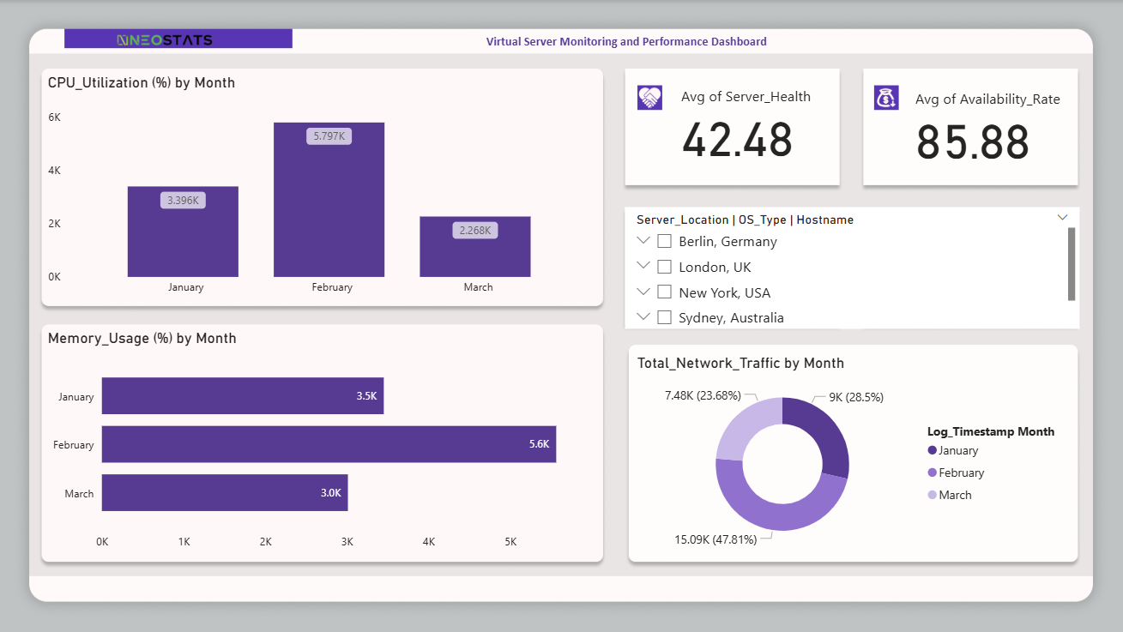

Slide 12
Implementing Different Approach and Learning
• While practicing database-based pipelines, I also worked with PostgreSQL using a Neon cloud database connected through DBeaver. In that setup, SQL queries were used to process the data before connecting it to Power BI for visualization
• For this project, I focused on building the data pipeline using Python to load, clean, and process the server log dataset. The processed data was then used to create the Power BI dashboard for monitoring server performance
• I am currently learning Azure and exploring how similar data pipelines can be implemented using Azure services such as Azure Data Lake and Azure SQL Database
• This project helped me understand how data can move from raw logs to meaningful insights through a structured data pipeline and dashboard

Slide 13
Data Transformation
Data quality checks was performed to remove duplicates and validate system metrics
• Timestamp coloum were converted into proper datetime format
• Additional metrics were created to generate meaningful insights
New metrics:
1) Total Network Traffic 2) Availability Rate 3) Server Health Score
• Total Network Traffic measures overall data transfer activity
• Availability Rate measures system reliability
• Server Health Score summarizes overall system condition

Slide 14
Server Monitoring Power BI Dashboard
• CPU utilization monitoring
• Memory usage analysis
• Network traffic monitoring
• KPI indicators for system health
• slicer for server location, OS type, and hostname

Slide 15
Thank You “NEOSTATS”

